Slide 1

MyPersonalAIAssistant
APython-basedVoice-
ControlledApp
[sorojkumarpanda]

Slide 2

Introduction:BringingAItoYourDesktop
Myprojectisaboutcreatingasmartdesktopvoiceassistant usingPython.Itcanlistentowhatwesay,understandthe command,andgivetheansweronscreen—justlikearealAI assistant.The mainaimistomakecomputerinteractionsimple andnatural.
Itmainlyfocuseson:-
Understandingspokencommands,
Performingdifferenttasksbasedonthosecommands,
andShowingcleartextresponses.

Slide 3
CoreFeatures&ExpandingCapabilities
Real-timeInformation
Myassistantcantellthecurrenttime andshowlive weatherupdatesforany cityusingonlineAPIs.
Productivity&WebAccess
ItcanopenYouTube oranywebsite justbygivingavoicecommand, makingbrowsingeasier.
KnowledgeRetrieval
ItcansearchWikipediaandgiveshort answersondifferenttopics.
Entertainment&Media
Usingpywhatkit,itcanplayanysong onYouTube,actinglikeapersonal DJ.
Memory&Note-Taking
ItusesanSQLitedatabasetosaveand showpersonalnotes,soimportant informationisneverlost.

Slide 4
TheRobustTechnologyStack
OurAIassistantisbuiltuponafoundationofpowerfulandversatileopen-sourcetechnologies,ensuringbothfunctionalityandextensibility.
CoreLanguage:Python
Pythonisthemainlanguageusedbecauseit’s easytoread,hasmanyusefullibraries,and hasalargecommunityforsupport.
VoiceI/O:
speech_recognition
The"Brain"(NLP):Scikit-learn
ItusesTF-IDFVectorizerandLogistic Regressiontounderstandthemeaningof usercommands.
&
pyttsx3
speech_recognitionisusedtoconvertvoice totext(listening).pyttsx3canbeusedfortext tospeech(replyingbyvoice).(Inmyproject, onlylisteningisused.)
Database:SQLite3
Usedtostoreandretrievenotesorpersonal datalocallyandefficiently.
WebIntegration:
requests
,
webbrowser
,
wikipedia
,
pywhatkit
pywhatkitTheselibrarieshelptheassistant togetonlinedata,openwebsites,search Wikipedia,andplayYouTubesongs.

Slide 5


OperationalLogic:HowItWorks
MyAIAssistantfollowsasimpleprocessoflistening,understanding,andacting.
1.ListenforCommand
Theassistanttakesvoiceinputfromthemicrophoneandwaitsforacommand.
Understand(NLP)
Thespeechisconvertedintotext,andtheLogisticRegressionmodelpredicts whattheuserwantstodo.
ExecuteAction
Accordingtothepredictedintent,theassistantrunsthecorrectfunction—like checking weather,openingYouTube,orshowingnotes.
RespondVerbally
Finally,itshowstheresultonscreen(andcanalsoreplybyvoiceifenabled).

Slide 6
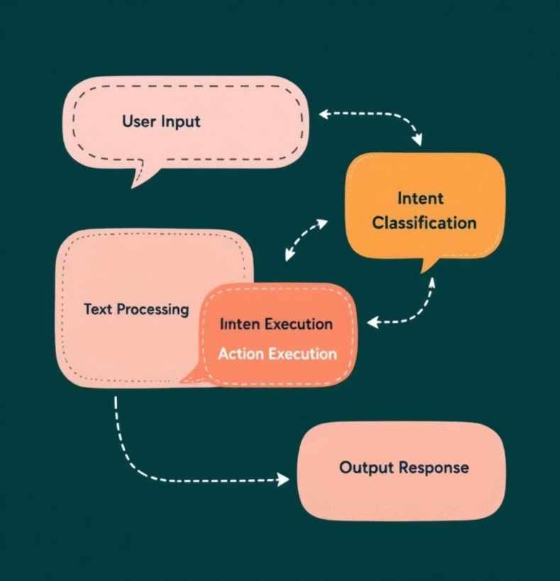
DeepDive:NaturalLanguageProcessing
ThemainpowerofmyassistantcomesfromNaturalLanguageProcessing,orNLP,which helpsitunderstandwhattheusersays.
FromSpeechtoTextWhenwespeak,thespeechrecognitionlibrarychangesour voice intotext.
FromTexttoMeaning(IntentDetection)ThattextissenttoatrainedNLPmodel.The TF-IDFVectorizerconvertsthewordsintonumbersbasedontheirimportance.Then,a LogisticRegressionmodelreadsthosenumbersanddecideswhattheuserwantsto do,suchas“play song,”“getweather,”or“set note.”
Inshort,theassistantconvertsspeech→text→intent→action.

Slide 7

DataManagement:TheSQLiteHeart
Efficientdatahandlingiscrucialforpersonalassistants,especiallyforfeatureslikenote-taking.
Secure& LocalNoteStorage
MyassistantusesSQLite,asimplefile-baseddatabasethatkeepsalldata safelyonthelocalsystem.
Simple:Noserversetupisneeded—easytouseandmanage.
Portable:Alldataisstoredinonesinglefile,soit’seasytomoveorbackup.
Reliable:ItisACID-compliant,whichmeansitkeepsdatasafeandaccurate.
So,userscansaveandviewnotesanytime,andtheirinformationstayssecure andlocal—notontheinternet.

Slide 8




WebConnectivity &ExternalServices
Apartfromlocaltasks,myassistantcanalsoconnecttotheinternetanduseonlinedata
1.requests:Usedtogetreal-timedatafromtheinternet,likeweatherinformationthroughAPIs.
2.webbrowser:Helpstoopenwebsitesdirectlyinthecomputer’sdefaultbrowser—forexample,YouTubeoranylinktheusersays.
3.Wikipedia:AllowstheassistanttosearchtopicsonWikipediaandshowshort,usefulinformation.
4.pywhatkit:UsedtoplayanysongonYouTubeautomaticallybasedontheuser’scommand.

Slide 9

Conclusion:ASteppingStoneto AdvancedAI
Thisprojectisasuccessfulexampleofcombiningdifferentcomputertechnologies tocreate aworkingAIPersonalAssistant.
ProjectSummary
WebuiltaPython-basedassistantthatcanUnderstandvoicecommands,UseNLPfor intentprediction,ManagedatausingSQLite,andConnecttotheinternetforreal-time information.
FutureEnhancements
AddaGraphicalUserInterface(GUI)forabetteruserexperience.Addmore featuresandskillstomaketheassistantsmarter.Useadvancedmachinelearning models(likeneuralnetworks)toimproveunderstandingandaccuracy.

Slide 10
ThankYou& Questions

